Slide 1
Fundamentals of Machine Learning
Compiled by: Radheshyam Baliga Bantwal

Slide 2
Introduction
Intersection of 2 disciplines
Software Engineering
Data Science
Machine learning (ML) is a branch of artificial intelligence (AI) that enables computers to learn from data and make decisions or predictions without being explicitly programmed for every task

Slide 3
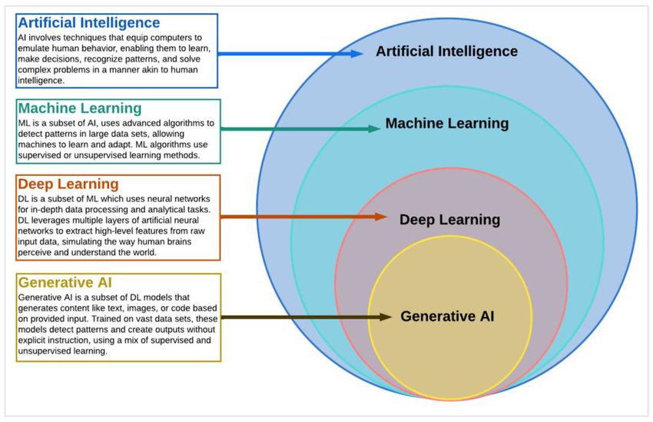
At a high level….

Slide 4
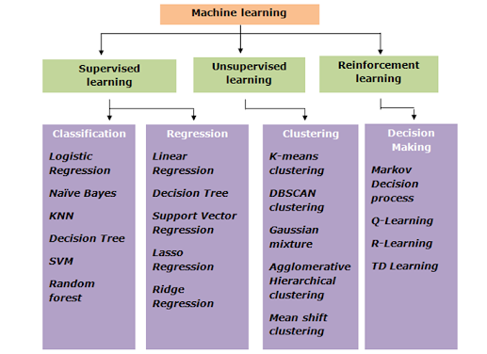
Types of Machine Learning

Slide 5
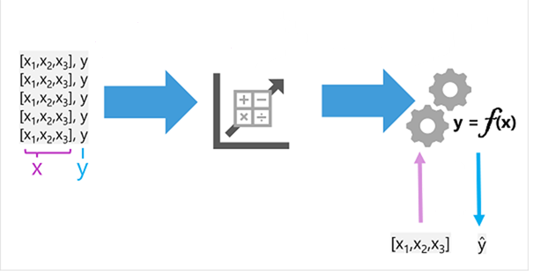
Machine Learning as a function

Slide 6
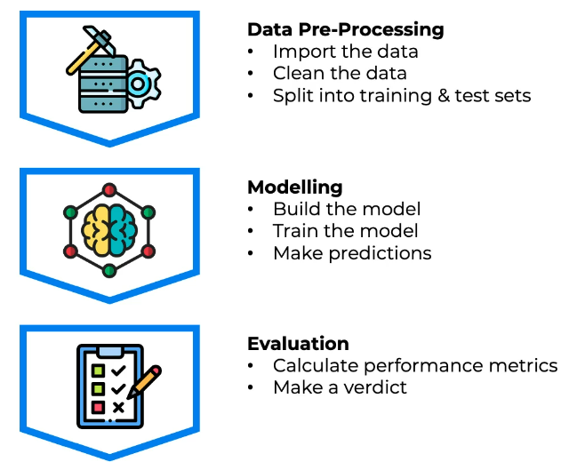
Machine Learning workflow

Slide 7
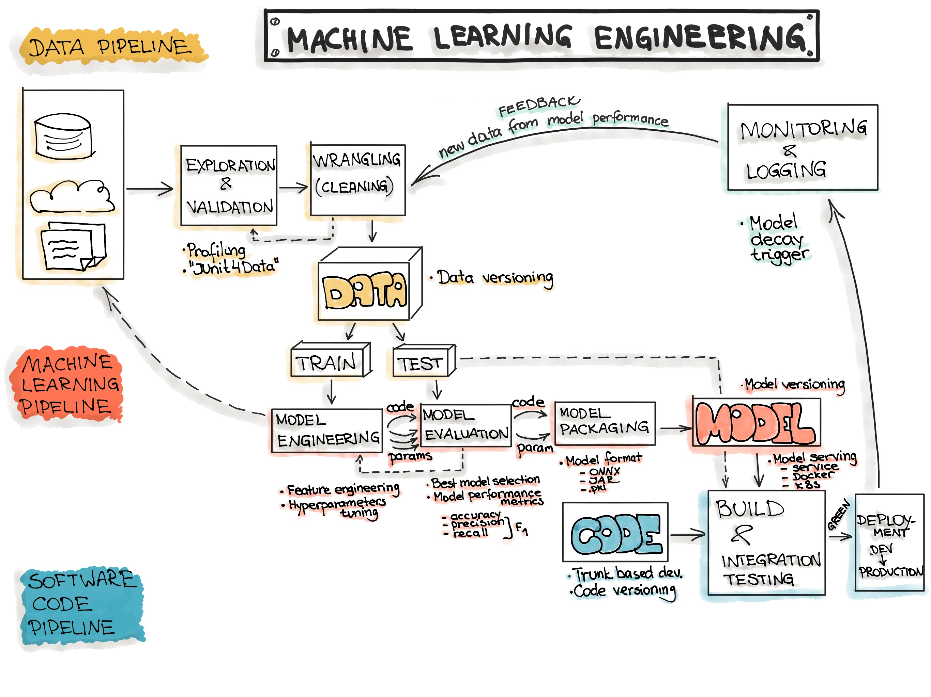
Machine Learning workflow

Slide 8
What next….
Data Pre-processing
Regression
Classification
Clustering
Natural language Processing
Deep Learning

Slide 9
Q & A

